Slide 1
Introduction to Decentralized Finance
Technological platform: Blockchain

Slide 2
What is Blockchain?
A growing system of interconnected records of transactions that are timestamped, secured, and agreed upon by participants.
The content of records can include almost everything pertinent to a transaction and provides users the ability to access, observe, and analyze the data stored on the blockchain.
A blockchain stands on three disciplines:
Accounting
Computer science
Governance system

Slide 3
1. Accounting
Ledgers - A ledger is used to keep track of money or other units going in, out. It serves as a diary to record transactions and financial matters occurring over the lifespan of an organization or system.

Slide 4
Example of ledger: Balance of poker chips
Ledger status at start 10:00AM
Player name | Number of chips
Daniel | 250
Elisa | 250
Pat | 250
Zach | 250
Ledger status after round 1 10:15AM
Player name | Number of chips
Daniel | 230
Elisa | 300
Pat | 270
Zach | 200
Ledger status after round 2 10:30AM
Player name | Number of chips
Daniel | 200
Elisa | 350
Pat | 280
Zach | 170

Slide 5
1. Accounting (continue)
Blockchain is a “digital” ledger that records and logs the transactions of a community of users.
Every participant maintains a copy of the ledger. Updates of the ledger are automatically sent out to all participants.
The blockchain provides similar services as a “notary” but performed through the execution of computer codes. In this way it eliminates the need for a third-party notary.

Slide 6
2. Computer science
Since blockchain is based on the internet, a vast array of computer systems are utilized to collaborate on a global scale to facilitate:
Networking: The internet itself is an example of a network. Each participating computer is called a node. Individual nodes are assigned unique addresses to ensure that all messages and connections are properly routed to the intended recipients.
Decentralization: Networks can be centralized or decentralized. Centralized networks rely on a single machine to do most of the work. In a decentralized network, instead, all computer nodes form the larger computer network. The advantage of a decentralized system is that it can share files, peripherals, and other tools. It is more reliable because it is not prone to a single point of failure. Decentralized networks are also scalable: it is sufficient to add more machines to the network if more resources are needed.

Slide 7
2. Computer science (continue)
Accessibility: There are different types of networks with different degrees of accessibility
Public blockchain networks – No restrictions as to who can access them.
Private blockchain networks – Require permission to join them.
Hybrid blockchain networks – A mix of public and private blockchain. Some information is freely available in the network while other requires permission.
Databases: Collection of structured information that is organized, stored, and assessed electronically from a computer system. Like networks, databases can be centralized or decentralized, and their access can be public or private.
Cryptography: Practice of securing communications via the process of encryption and decryption to transmit messages between trusted parties. It ensures data confidentiality, integrity and authenticity. One of the most used cryptographic technique in blockchain is called hashing.

Slide 8
Example of hashing: SHA-256
https://emn178.github.io/online-tools/sha256.html
Text to encrypt | Hash value
Blockchain | 625da44e4eaf58d61cf048d168aa6f5e492dea166d8bb54ec06c30de07db57e1
blockchain | ef7797e13d3a75526946a3bcf00daec9fc9c9c4d51ddc7cc5df888f74dd434d1
This is an example | 47fb563cc8f86dc37c86d08bc542968f7986acd81c97bf76db7ad744407fe117

Slide 9
2. Computer science (continue)
Digital Identity: Information that can be used to unambiguously identify someone or something online. It contains information such as national ID, credit score, driving records, etc.
Digital Wallets: Electronic devices or online services that allow users to store digital securities, make electronic payments, and maintain personal information. The content of a digital wallet stays secure thanks to key encryption. Two keys are created with a new digital wallet:
Public key: shared with others so that they can communicate with you.
Private key: not shared but it is necessary to see the content of the communication.
The public and private keys are similar to email addresses (public keys) and passwords (private keys).

Slide 10
3. Governance
Set of rules and processes under which a system operates. They shape the way participants use the system, how decisions are made, and the distribution of privileges and responsibilities.
Protocols: Programmed sets of rules for electronic communication.
Consensus: Process by which participants come to a mutual understanding about what is published in the ledger. It is vital to have rules governing how things are sorted out in case of a dispute. In a centralized system one computer (node) acts as a referee and decides. In a decentralized system, instead, many opinions need to be sorted out and aggregate in decisions.

Slide 11
Distributed ledger technology
A distributed ledger contains database spread across multiple locations, nodes, or participants.
It differs from a centralized ledger because it gives control of information and transactions to all users.

Slide 12
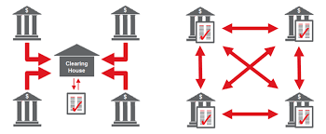
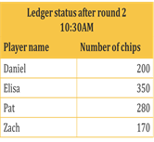
Centralized and distributed ledgers
Centralized
ledger
Distributed
ledger
Daniel
Elisa
Daniel
Elisa
Pat
Zach
Pat
Zach

Slide 13
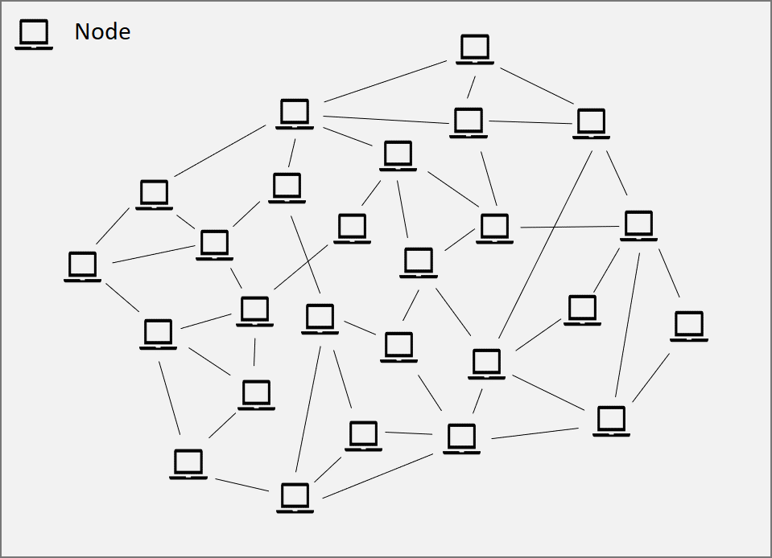

Slide 14
Centralized and distributed ledgers
Centralized ledgers use the trust of the centralized institution (clearing house) to update the ledger.
Distributed ledgers use consensus mechanisms among their users to replace the trust and eliminate the need of a single organization to oversee the data and its handling.
The consensus mechanism allows distributed ledgers to provide greater security, enhance efficiency, and lower costs.

Slide 15
Blockchain as distributed ledger
Blockchain is a type of distributed ledger technology: All blockchains are distributed ledgers, but not all distributed ledgers are blockchains.
The feature that characterizes a blockchain is that transactions are mathematically linked. This feature offers a more secure and efficient way to create immutable logbooks.

Slide 16
Example of ledger: Balance of poker chips
Ledger status at start 10:00AM
Player name | Number of chips
Daniel | 250
Elisa | 250
Pat | 250
Zach | 250
Ledger status after round 1 10:15AM
Player name | Number of chips
Daniel | 230
Elisa | 300
Pat | 270
Zach | 200
Ledger status after round 2 10:30AM
Player name | Number of chips
Daniel | 200
Elisa | 350
Pat | 280
Zach | 170

Slide 17
Linking transactions
Transactions are recorded in blocks:
A set of new transactions are grouped together forming a “block”.
A block is like a book where transactions are recorded. However, the book is not physical but digital.
A block contains information that is mathematically encrypted through the process of hashing. It contains three pieces of information:
The hash (identification code) of the previous block
Data for the current block: the transactions to be recorded and included in the block
The hash (identification code) of the current block
By including the hash of the previous block, the newly formed block gets linked to previous blocks (previous transactions).

Slide 18
Linking blocks
Block 1
(Genesis)
Block 2
Block 3
Hash previous block: 00000
Encrypted transaction data included in current block: “…..”
Hash current block: 096U4
Hash previous block: 096U4
Encrypted transaction data included in current block: “…..”
Hash current block: 085Y3
Hash previous block: 085Y3
Encrypted transaction data included in current block: “…..”
Hash current block: 6EP9W

Slide 19
Example of block created at 10:15 on 8/28/2025
https://emn178.github.io/online-tools/sha256.html
Hash number of previous block Transactions included in this block Hash number of this block | 625da44e4eaf58d61cf048d168aa6f5e492dea166d8bb54ec06c30de07db57e1 Daniel transferred 20 chips to Elisa at 10:04 on 8/28/2025 Zach transferred 30 chips to Elisa at 10:08 on 8/28/2025 Zach transferred 20 chips to Pat at 10:12 on 8/28/2025 7b23127f31637fe47acb149497f378c0973132958d9880ecf85519f234760055

Slide 20
Next block created at 10:30 on 8/28/2025
Hash number of previous block Transactions included in this block Hash number of this block | 7b23127f31637fe47acb149497f378c0973132958d9880ecf85519f234760055 Daniel transferred 30 chips to Elisa at 10:19 on 8/28/2025 Zach transferred 20 chips to Elisa at 10:23 on 8/28/2025 Zach transferred 10 chips to Pat at 10:27 on 8/28/2025

Slide 21
Creating a blockchain transaction
A transaction begins when one party decides to send units of value to another.
Suppose that Daniel sends 50 chips (tokens) to Elisa. To do that, Daniel needs to access his digital wallet where the chips are digitally stored and make a request to transfer the 50 chips to Elisa’s wallet, by indicating the address of Elisa’s wallet (public key). Daniel also needs to provide credentials (private key of his wallet) to verify that the request really comes from him.
At this point, the system creates an encrypted digital signature for Daniel. With encryption, the signature cannot be forged, and it proves that the transaction is ordered by Daniel. This is because the digital signature requires the use of the private key that only Daniel knows (unless it was stolen).
The transaction ordered by Daniel, in encrypted format, is then included in a new block.

Slide 22
Creating a blockchain transaction (continue)
The new block containing Daniel’s transaction is now transmitted to all participants on the blockchain. Each participant checks the validity of all transactions included in the block. If everything checks out satisfactorily, each participant should approve the block.
The blockchain system looks at all participants and determines whether consensus has been reached (that is, participants agree that all transactions included in the block are valid). If the answer is positive the new block is approved and ready to be linked to previous approved blocks.
Once the block is added to the blockchain, all transactions become definitive.
The update of the blockchain is now complete and everybody gets a copy of the latest version of the blockchain.

Slide 23
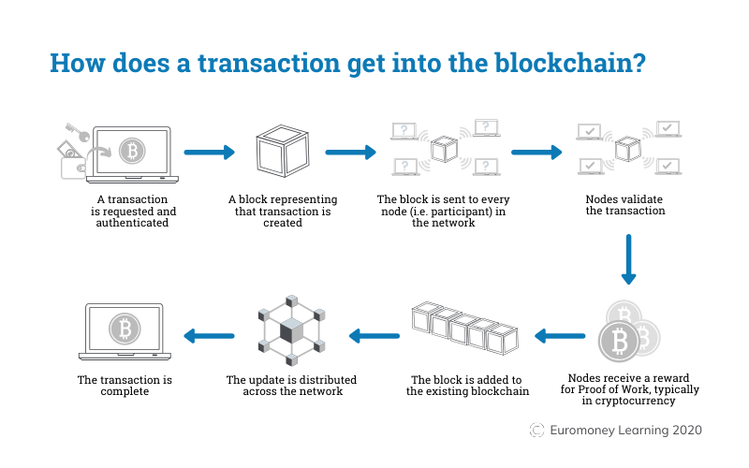

Slide 24
Preventing double-spending
A digital coin or token can be easily replicated with a copy.
How can we be sure that the owner of the coin does not spend it multiple times?
The idea is to record the history of every digital coin and place the history in a ledger that is accessible to everybody. By checking the history every participant will be able to verify that a coin has not been spent twice.
To discourage tampering the ledger, block of transactions are timestamped and linked to one another using mathematical tools. Anyone attempting to modify the data of any block will be forced to rebuilt all blocks added since then. This become increasingly difficult as more blocks are added.

Slide 25
Tampering a transaction in block 2
Block 1
(Genesis)
Block 2
Block 3
Hash previous block: 00000
Encrypted transaction data included in current block: “…..”
Hash current block: 096U4
Hash previous block: 096U4
Encrypted transaction data included in current block: “…..”
Hash current block: 085Y3
Hash previous block: 085Y3
Encrypted transaction data included in current block: “…..”
Hash current block: 6EP9W

Slide 26
Tampering a transaction in block 2
Block 1
(Genesis)
Block 2
Block 3
Hash previous block: 00000
Encrypted transaction data included in current block: “…..”
Hash current block: 096U4
Hash previous block: 096U4
Encrypted transaction data included in current block: “…..”
Hash current block: 032K9
Hash previous block: 085Y3
Encrypted transaction data included in current block: “…..”
Hash current block: 6EP9W

Slide 27
Verification of sender with digital signature

Slide 28
Verifying the identity of the sender
The verification that the sender has the right to order a transfer is done through the verification of the digital signature.
How does a digital signature work?
Any digital wallet has a private key (known only to the owner of the wallet) and a public key (known to all participants). The two keys are linked together.
The owner of the coins encrypts the text that describes the transaction using the private key.
To verify the identity of the sender, we have to decrypt the encrypted text using the public key.
If the public key decrypts the encrypted data, it proves that the transaction was ordered by the legitimate owner.
Since private and public keys are linked together, it is NOT possible to decrypt the encrypted text with another public key. Also, if the transaction is encrypted with a different private key, the public key will not decrypt the encrypted text.

Slide 29
Example: Alissa transfers 0.1 Bitcoin to Brandon
Alissa: Public Key/Address = AC1a2 Brandon: Public Key/Address = FM6v4
Private Key = DEG4b9 Private Key = NSN8h7
Encryption with private key
DEG4b9
Alissa submitted
transaction
Encrypted transaction
(digital signature)
May 11, 2026 13:23:45
Transfer 0.1 from AC1a2 to FM6v4
IhXt5l3bakHV53EPBfF3W1MCj9
YlkjOUYFiyd725VCrYTRlg5098X
Verification: Decryption with
public key AC1a2
May 11, 2026 13:23:45
Transfer 0.1 from AC1a2 to FM6v4

Slide 30
Fake transaction: Alissa transfers 0.1 Bitcoin to Brandon. However, the transaction is ordered by Brandon
Alissa: Public Key/Address = AC1a2 Brandon: Public Key/Address = FM6v4
Private Key = DEG4b9 Private Key = NSN8h7
Encryption with private key
NSN8h7
Brandon submitted
transaction on behalf of Elissa
Encrypted transaction
(digital signature)
May 11, 2026 13:23:45
Transfer 0.1 from AC1a2 to FM6v4
EPBfF3W1MCj9YlkjOUYFiyd725
YTRlg5098XIhXt5l3bakHV53VCr
Verification: Decryption with
public key AC1a2
Decryption failed

Slide 31
Hash Function
Transactions are recorded in the blockchain in hashed format, not original format.
Hashing converts any digital object in a new digital object of fixed length.
For example, SHA-256 takes any digital input and computes a 256-bit output.
Data is stored in computers as sequences of 0 and 1. Thus, a 256-bit output is a sequence of 256 cells, each containing either 0 or 1. The possible combinations are 2²⁵⁶.
For convenience, the 256-bit object is represented with 64 elements (instead of 256), with each element taking 16 possible values: 0, 1, 2, 3, 4, 5, 6, 7, 8, 9, a, b, c, d, e, f.
Note that 2²⁵⁶= (2⁴)⁶⁴= 16⁶⁴.
Once an object has been hashed, it is practically impossible to recover the original object from the hash output. Similar to fingerprints: if we know the person, it is easy to create the fingerprints of that person. Having the fingerprints, however, does not allow us to determine who created them.

Slide 32
Why are transactions hashed?
It provides an easy way to verify the validity of the blockchain making its alteration difficult:
Anyone who would like to verify a transaction will hash the transaction and check whether the hashed output is the same as recorded in the blockchain.

Slide 33
The process of adding a new block to the blockchain

Slide 34
Nodes and miners (Bitcoin platform)
Computers connected to the network are called full nodes. Only some of them are miners.
Full nodes: Check that any new block added to the blockchain is made up of transactions that are compatible with the rules (the protocol). In particular, the nodes check that there is no double-spending.
Remark: Checking the validity of transactions is not computationally expensive.
Miners: Pool together transactions in a new block. The new block of transactions is then added to the chain.
Remark: This task is very expensive in terms of computing time and requires large quantities of electricity. Computation is required for the proof-of-work.

Slide 36
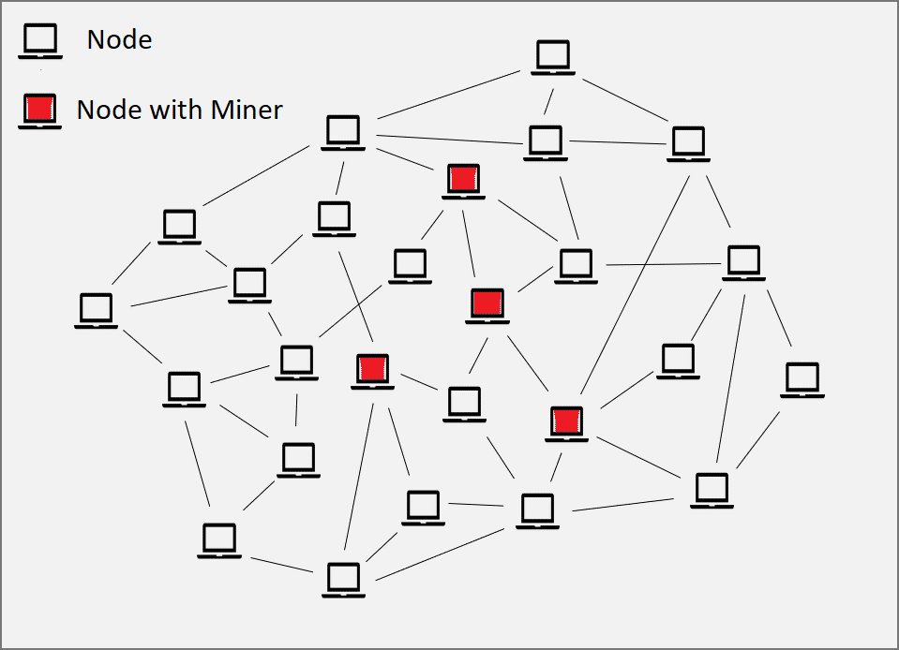

Slide 37
Miners
Pool together a set of transactions submitted to the network but not yet confirmed in a new block.
All miners do this at the same time but only one will eventually be able to add the newly formed block to the blockchain. This is because miners compete with each other to win the right to add a block to the blockchain.
How is the winner selected? It will be the miner who finds the solution to a mathematical puzzle before anyone else.
Example: Suppose that miners need to find a number with a maximum of three digits. For example, 673.
A three-digit number can take 1,000 possible values. Therefore, to find the right number, miners can try a maximum of 1,000 guesses.
The first miner that guesses 673 will have the right to add the block to the blockchain.
Guessing and verifying requires computer power. Therefore, miners with more powerful equipment have higher chances of winning because they can guess and verify more numbers over the same length of time.
The winning miner gets compensated with new coins created from scratch and/or fees that users pay for executing their transactions.

Slide 38
Lottery in bitcoin
A miner generates a guess as follows:
After creating a block, the miner hashes the block and obtains a hash number.
The mathematical puzzle is solved if the first N digits of the hash number contains only zeros.
Obviously, if we hash the same block, we get the same hash number. Thus, to generate a different hash number, we need to modify the content of the block. This is done by including in the block an additional number called Nonce.
In any trial, the miner guesses the Nonce randomly, hashes the block, and checks whether the obtained hash number has zeros in the first N digits. If not, the miner keeps changing the guess for the Nonce until the desired hash number is found.

Slide 39
Blockchain
Block 1
(Genesis)
Block 2
Block 3
Hash previous block: 00000
Encrypted transaction data included in current block: “…..”
Hash current block: 096U4
Hash previous block: 096U4
Encrypted transaction data included in current block: “…..”
Hash current block: 085Y3
Hash previous block: 085Y3
Encrypted transaction data included in current block: “…..”
Hash current block: 0EP9W
Confirmed

Slide 40
Blockchain
Block 1
(Genesis)
Block 2
Block 3
New Block
No yet linked
Hash previous block: 00000
Encrypted transaction data included in current block: “…..”
Hash current block: 096U4
Hash previous block: 096U4
Encrypted transaction data included in current block: “…..”
Hash current block: 085Y3
Hash previous block: 085Y3
Encrypted transaction data included in current block: “…..”
Hash current block: 0EP9W
Hash previous block: 0EP9W
Encrypted transaction data included in current block: “…..”
Nonce: 005315
Confirmed

Slide 41
Who is the winning miner?
The first miner who finds a hash number for the block that contains only zeros in the first N digits.

Slide 42
Guessing the Nonce – Hash with one zero
Hash previous block: 0EP9W
Encrypted transaction data included in current block: “…..”
Nonce: 005315
Hash function
5F7C4

Slide 43
Guessing the Nonce – Hash with one zero
Hash previous block: 0EP9W
Encrypted transaction data included in current block: “…..”
Nonce: 005315

Slide 44
Guessing the Nonce – Hash with one zero
Hash previous block: 0EP9W
Encrypted transaction data included in current block: “…..”
Nonce: 785315
Hash function
Y59T3

Slide 45
Guessing the Nonce – Hash with one zero
Hash previous block: 0EP9W
Encrypted transaction data included in current block: “…..”
Nonce: 785315

Slide 46
Guessing the Nonce – Hash with one zero
Hash previous block: 0EP9W
Encrypted transaction data included in current block: “…..”
Nonce: 374826
Hash function
0HK5L

Slide 47
Winning miner
The winning miner sends the block with the Nonce to all nodes. This is the proof-of-work.
The nodes check whether the solution is valid. They also verify the validity of all transactions included in the block.
If 50% of the nodes confirm validity, the block is added to the chain.
The digital wallet of the winning miner gets credited with newly minted coins and/or with transaction fees paid by users.

Slide 48
Blockchain
Block 1
(Genesis)
Block 2
Block 3
Hash previous block: 00000
Encrypted transaction data included in current block: “…..”
Hash current block: 096U4
Hash previous block: 096U4
Encrypted transaction data included in current block: “…..”
Hash current block: 085Y3
Hash previous block: 085Y3
Encrypted transaction data included in current block: “…..”
Hash current block: 0EP9W
Confirmed

Slide 49
Blockchain after addition of new block
Block 1
(Genesis)
Block 2
Block 3
Block 4
Hash previous block: 00000
Encrypted transaction data included in current block: “…..”
Hash current block: 096U4
Hash previous block: 096U4
Encrypted transaction data included in current block: “…..”
Hash current block: 085Y3
Hash previous block: 085Y3
Encrypted transaction data included in current block: “…..”
Hash current block: 0EP9W
Hash previous block: 0EP9W
Encrypted transaction data included in current block: “…..”
Hash current block: 0HK5L
Confirmed

Slide 50
Interactive example
Link to blockchain example on google sheets

Slide 51
Bitcoin blockchain data
Bitcoin blockchain

Slide 52
Why do miners need to solve a very expensive mathematical puzzle?

Slide 53
Benefits of blockchain
Trustworthy
A network of users provides self-policing over the activities of the blockchain
Coded procedures enable to track and verify all data stored on a chain
Secure
Key encryption protects the rights of individual users while allowing everyone to view the content of the ledger and its history
Mathematical rules ensure that the records kept on the chain are temper-proof
The decentralized nature of the network prevents any single point of failure. Failure requires the collaboration of many users, which makes blockchain less susceptible to fraud and cybercrime issues.

Slide 54
Benefits of blockchain
Transparent
The system should remain neutral and unbiased because the platform is not centrally controlled.
Transactions are conducted openly on a shared ledger and any message is sent to all peers. No particular entity can stop that from happening.
Efficient
Digital operation creates opportunities for streamlining processes and automate tasks like auding, reporting, and notarizing.
Cutting the middlemen allows cost reduction and quicker processing
Predefined rules can eliminate disputes between participants
Innovative
The architecture of blockchain enhances the interoperability of existing applications and facilitates coordination.
Blockchain is adaptable: upgrades and other enhancements can be undertaken when needed.

Slide 55
However
It uses a lot of energy
To win the competition and generate the proof-of-work, miners run many computers that requires a lot of electricity.

Slide 56
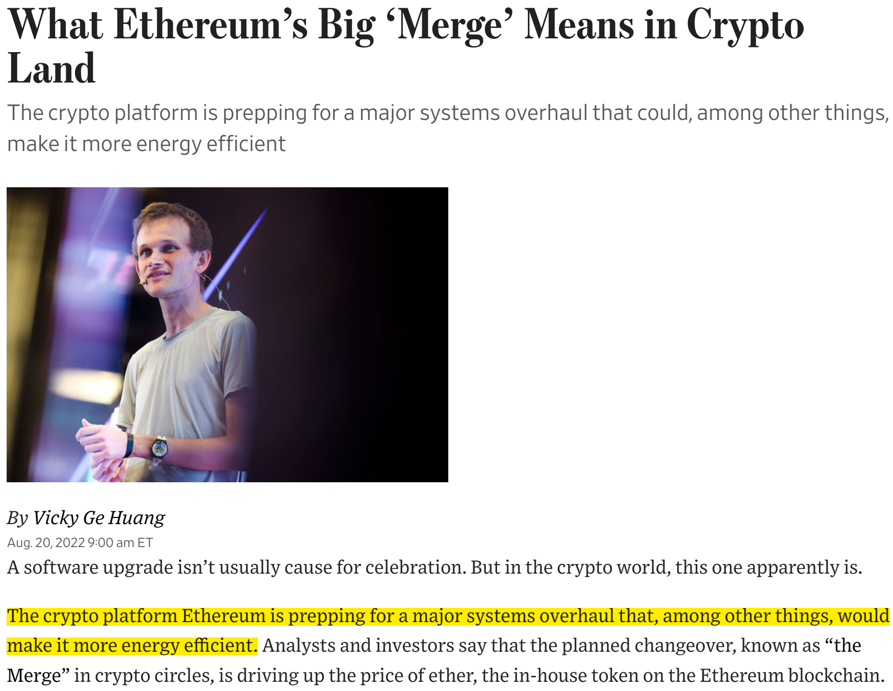
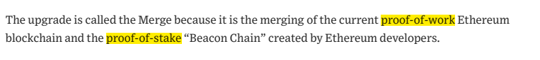

Slide 57
Proof-of-work vs. proof-of-stake
In the proof-of-stake nodes have different weights or voting rights for validating transactions.
The voting rights are determined by the number of coins owned and locked by the node in the blockchain (the stake). To gain the voting rights, the coins must be deposited in a special digital wallet, which is temporarily frozen. Higher is the number of coins staked, and higher is the number of voting rights.
While in the proof-of-work competition is based on computational power used to solve a mathematical puzzle, in the proof-of-stake the winner is selected randomly based on the amount of staked assets. Higher is the amount of assets staked by a validator, and higher is the probability of being chosen as the winner with the right to add a new block to the chain.
Some cryptographic calculations are still required but they are much simpler to execute and require much less electricity.

Slide 58
Proof-of-work vs. proof-of-stake (continue)
The reward for miners (more properly called forgers or minters in the proof-of-stake protocol) has a different structure. User fees tend to be more important than newly created coins.
The main idea underlying the proof-of-stake consensus mechanism is that those who place a larger stake, have a higher incentive to keep the network secure:
If the system fails, the value of the staked coins is likely to drop. Thus, validators with large amounts of staked coins have a greater interest to maintain the normal functioning of the system.

Slide 59
Interactive example
Link to blockchain example on google sheets

Slide 60
Staking
If a cryptocurrency allows staking, holder of the coins can earn a reward on the owned coins.
There are two ways to participate:
Becoming a full validator. This requires a minimum investment (Ethereum requires a minimum of 32 ETH), technical knowledge, dedicated computer that can perform validations without downtime. It is a full commitment and could be risky because downtime can cause slashing of the committed funds.
Contributing through an exchange (for example Coinbase). In this case the investor can contribute with any amount and without operating any validator hardware. The supplied cryptocurrencies will be used by the network to increase the stake in the validation process based on the “proof-of-stake” protocol.
In the second case, staking is similar to lending coins to validators. Validators are willing to pay a compensation to the owners of the coins because they allow them to validate more transactions and, thus, earn more rewards in the “proof-of-stake” protocol.

Slide 61
Risk of staking
Cryptocurrencies are volatile. Drops in price can easily outweigh the earned rewards.
Staking could be a good option for someone who plans to hold the asset for the long term regardless of the price swings.
Some cryptocurrencies require a minimum lock-up period while the asset cannot be withdrawn from staking.
The asset becomes illiquid.
Withdrawal from the staking pool could be subject to a waiting period.
Reduces the liquidity of the asset.
There is a counterparty risk coming from the staking pool operator.
If the validator doesn’t do the job properly, there are penalties, and the funds can be slashed.
Staking pools can be hacked.
It could result in a total loss of staked funds.

